Slide 1
HIRING STARS PROGRAM
March 27, 2016

Slide 2
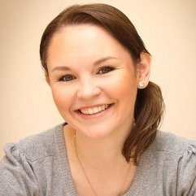
About me
Olesya Kaminskaya
Talent Aquisition Lead at EPAM
9+ years in recruiting
5 + years in IT

Slide 3
Agenda
Why do we do this?
Do we need some special rules?
Who we are looking for?
Where could we find out our stars?
Is there any process specific?

Slide 4
Why do we do this?
Global Delivery Hiring
Resource Managers
Current Needs
CTO Hiring
VP’s
Strategic vision

Slide 5
Do we need some special rules?
1/High-level dedicated interviewers team
2/Max 3 interviews to make a decision
3/No discussion on salary at the first stages

Slide 6
The main condition
Awareness and willingness to follow the rules at all stages

Slide 7
Who we are looking for?
Solution Architects
CTO’s
Principle Engineers
Geeks
Competence
Centers
Experts
Enterprise Architects
Delivery and pre-sales Managers
Consultants

Slide 8
Where could we find out our stars?
Well Known Experts
Community Leaders
Conference Speakers
Technology Bloggers
Product / Service Architects
Former EPAM Employees
Top Technologists from Competitor Companies
CTOs
Architects
Principal Engineers
Referrals by EPAM experts

Slide 9
Specific
Long terms
- Commitments to the customers/employer
- Own career plan (internal opportunities, relocation)
- Different starting points of the hiring process
High communication level
and high requirements on both sides
NO formalistic approach to the experience

Slide 10
Dear Olesya,
Thanks a lot for being open with me as well! Tried to save
your time :)
I heard many good things about your company and no brainer there is no limits for the guys like you!
If something will come under your radar, potentially even senior mgmt level - will be glad to keep in touch.
Thanks again and have a great day!
ATB,
Dmitry

